Slide 1
WELCOME

Slide 2
Mini project :
automatic SolAr Orientation USING Arduino

Slide 3
Project TEAM MEMBERS ARE :
Sagar
Arya
Vaishnavi
Radhika

Slide 4
MENTORS
Dr Ajit Patil sir
( )
Miss. Shubhada Sawakhande
( )

Slide 5
Contains
Introduction - Problem statement
Block diagram- Flow Chart
Working Principle
Hardware Components
Diagram
Conclusion
Reference
Thank You

Slide 6
Introduction :
Renewal energy solutions are becoming popular these days
Maximizing output from solar system increases efficiency
PROBLEM STATEMENT :
Presently Solar panels are fixed types, which lower the efficiency.
Maintaining the direction as per the earth’s rotation around sun, maximize the efficiency

Slide 7
Solar Orientation system has 35% higher generating power than fixed
Solar tracking system based on Arduino can adjust automatically.

Slide 8
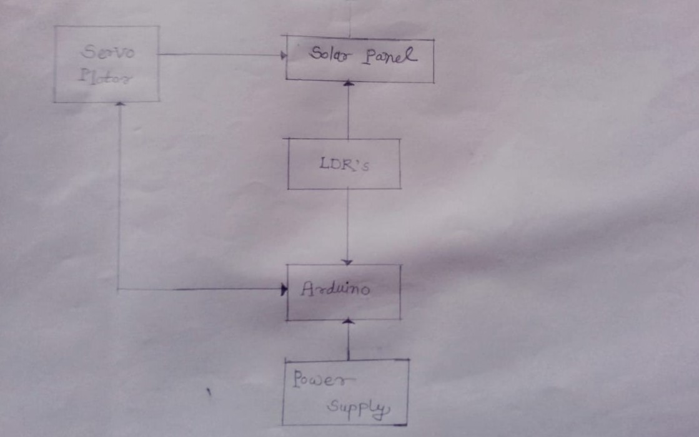
BLOCK DIAGRAM:

Slide 9
WORKING PRINCIPLE :
Automatic Tracking Solar Orientation Using Arduino

Slide 10
Hardware Components:
Solar panel
LDR sensors
Servo Motor (SG90)
Resistors (10k)
Jumper wires
Arduino UNO
Ethernet Shield (Wiznet WS 100) for Arduino

Slide 11
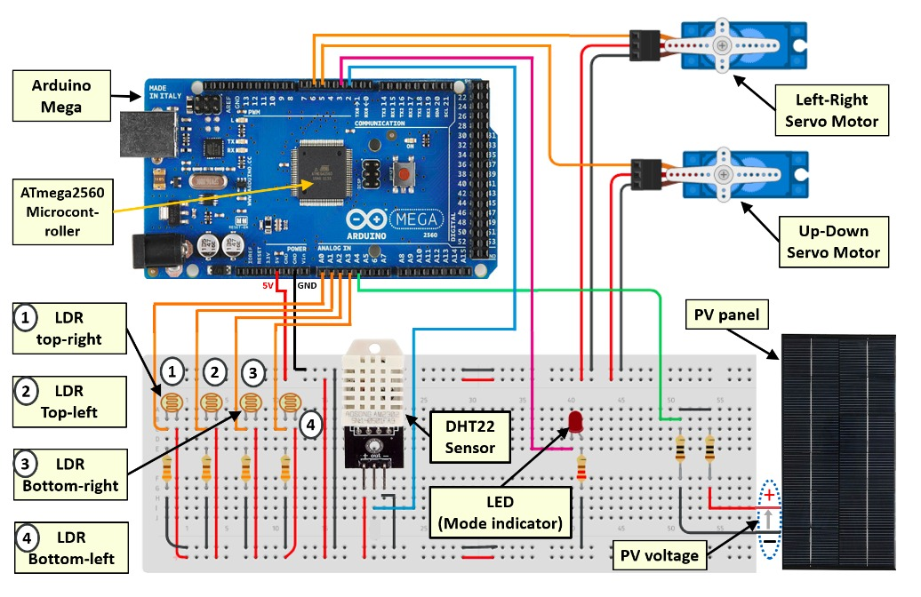
Diagram :

Slide 12
Conclusion
On one hand we can see the worlds energy resources depletion be a major problem.
On the other hand global warming , which is a major concern .
Switching to solar power , which is clean and green and enhancing its efficiency by using sun trackers is a great option in the near future.

Slide 13
Reference:
Reference Link:
https://link.springer.com/chapter/10.1007/978-3-030-64565-6_4

Slide 14
Thank you.

